Slide 1
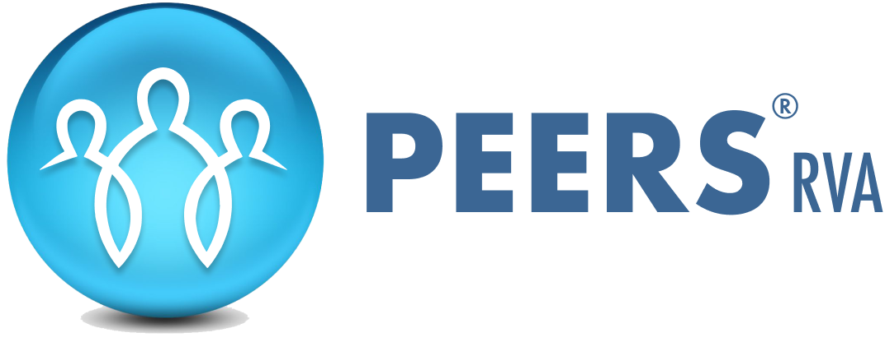
Paying My Bills Lesson 12: Controlling Debt
Debt Resources Financial Wellness
Directions: Use these resources from the Consumer Financial Protection Bureau to track your debts, calculate your debt-to-income ratio, prioritize bills, prepare to talk with debt collectors.
Track your debts and how much you owe with this Debt log
Debt Getting in Your Way? Get a Handle on It
Debt log on pg. 6
Debt-to-income calculator
Prioritizing bills helps you manage issues when you can't pay them on time
You can be prepared to ask questions When debt collectors call

Slide 2
Paying My Bills Lesson 12: Controlling Debt
Bill Communication Financial Wellness
Worksheet
Directions: Complete one worksheet for each past due bill.
Date: __________________ Account Number: ________________________________
Name of Company: _____________________________________________________________
Address: ______________________________________________________________________
Phone Number: _________________ Person I Talked To: ____________________________
Amount of Past Due Bill: _____________ Problem: _____________________________
What do I want? _______________________________________________________________
______________________________________________________________________________________________________________________________________________________________
What questions do I have? ______________________________________________________
______________________________________________________________________________________________________________________________________________________________
Action to to be taken:
By Me: ___________________________________________________________________
By Them: _________________________________________________________________
Do we need to meet or talk again? ______________________________________________

