Slide 1
Paying My Bills Lesson 10: Paying Bills
Should I Have a Bank Financial Wellness
Account?
Directions: A bank or credit union checking and/or savings account can help you manage your income safely, securely, and conveniently.
Money handling services, such as check cashing offered with a bank account, may be less costly than a check-cashing service. A well-managed account will help you develop a record of paying bills and saving money to build a credit history. To build a positive credit history, you need to use your account carefully and correctly. Poor account use habits cost money. Use these statements to see if you are ready to have a bank account.
Respond to each statement below by placing a checkmark in the YES or NO column.
Yes | No
 |  | I have a source of income
 |  | I would deposit money in a timely manner
 |  | I would check my account balance monthly and confirm deposits have been made accurately
 |  | I would check my account balance monthly and confirm withdrawals are accurate and match my budget
 |  | I know the fees the bank will charge if I overdraft my account
 |  | I have the identification papers needed to open an account
 |  | I would not share my personal identification number (PIN)
 |  | I have a safe place to keep account information
Do I have any NO answers checked above? _____
Would I be able to change the NO answers to YES answers easily? _____
I am ready! _____ I am not ready yet! _____

Slide 2
Paying My Bills Lesson 10: Paying Bills
Financial Products Financial Wellness
That Meet Your Needs
Directions: Think about why you want or need a financial product or service. Check the boxes of the goal(s) that are most important to you. Read more about the financial products and services that meet those needs and decide which might be the best for you.
Goal | Products to Consider
I want a secure place to keep my money | Certificate of deposit (CD) Checking account Prepaid card Savings account
I want to make purchases without having to carry cash or go into debt | Checking account (with linked debit card) Prepaid card
I want a low-cost and easy way to pay and manage my bills | Bill payment service Checking account Money order Prepaid card
I want to pay my bills online or from my mobile device | Bill payment service Checking account Prepaid card
I want access to online or mobile banking (to do things like check my balance online or deposit a check with my phone) | Checking account Prepaid card
I want my paycheck deposited directly into an account I can access | Checking account Payroll card Prepaid card Savings account
I want to turn my paycheck into cash | Check cashing service Checking account Payroll card Prepaid card

Slide 3
Paying My Bills Lesson 10: Paying Bills
Financial Products Financial Wellness
That Meet Your Needs
Goal | Products to Consider
I want to build up savings | Certificate of Deposit (CD) Prepaid card (with savings wallet feature) Savings account
I want to save for education and training for myself or my child | 529 Plan
I want to buy a car | Auto loan
I want to buy a house | Mortgage
I want to get a small loan quickly | Auto title loan Credit card Pawn loan Payday loan
I want to build my credit history | Auto loan Credit builder loan Credit card Mortgage Secured credit card
I want to send money to someone | Money or wire transfer service Peer-to-peer transfer service (Venmo, Paypal, etc)

Slide 4
Paying My Bills Lesson 10: Paying Bills
Shopping for Bank Financial Wellness
Services
Directions: Think about why you want or need a financial product or service. Check the boxes of the goal(s) that are most important to you. Read more about the financial products and services that meet those needs and decide which might be the best for you.
Name of Bank or Credit Union:
Checking Account
Opening deposit needed
Minimum balance needed
Monthly service fee
Check printing cost (how many?)
Overdraft fee
Overdraft protection cost
Interest Earning Account
Minimum balance required
Monthly service fee
Interest rate paid/APR
ATMs (Automated Teller Machines)
ATM locations
Withdrawal fees
Account Services
Direct deposit
Check or cash card fees
Lost check or cash card fees
Money order cost
Cashier’s check fee
Remittance fee (sending money abroad, which countries?)
Bill paying or online banking fees
Account statement balancing fee
Electronic Transfer Account (ETA) (for government payments)

Slide 5
Paying My Bills Lesson 10: Paying Bills
Opening an Account Financial Wellness
Directions: Review the items you need to open the account and check them off as you gather them. Write down any questions you have. Get answers to all the questions listed to make sure you're aware of the terms, costs, and limitations of the account.
WHAT I NEED TO OPEN AN ACCOUNT | QUESTIONS I HAVE
A picture ID issued by a state, or the U.S. or foreign government (check which foreign IDs your bank or credit union accepts)
One of these second forms of identification Social Security card Birth certificate Bill with your name and address on it
Your Social Security number or ITIN (Individual Taxpayer Identification Number from the IRS); if you don’t have one, you may only be able to open a no-interest account
Money to put into the account
QUESTIONS I CAN ASK THE BANK OR CREDIT UNION | RESPONSES
Is there a monthly fee? If so, how much is it and can it be waived?
Is direct deposit available?
Do I have to pay for checks?
Are there per-check or transaction fees? How much are they?
Are there convenient, free ATMs located near where I live, work or shop?
Is there access to online bill paying services? What’s the cost to use?
What happens if I try to spend or withdraw more money than I have in my account (overdraft)?
Are there alerts when my balance gets low?
Will I earn any interest on the money in the account? What is the interest rate?

Slide 6
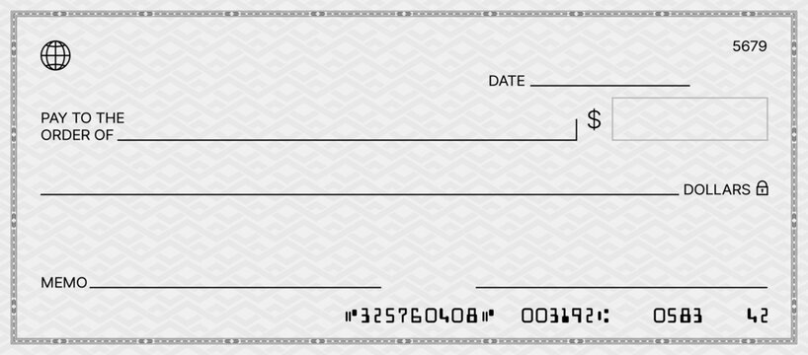
Paying My Bills Lesson 10: Paying Bills
Deposit & Check Financial Wellness
Practice
Directions: Practice making a deposit and writing a check using the information below.
Date: December 28, 2024
Cash for deposit: $11.34
Checks for deposit: $156.99 paycheck, $100 gift from Mom
Cash back: $20.00
Lee Y. Worker
9331 Main Street
Yourtown, ST 54321
Cash
Checks
Total from other side
Subtotal
Less cash
Total
Date ______________________
Deposits may not be available for immediate withdrawal
___________________________
Sign here if cash received from deposit
Deposit
Horizon Federal Bank
|:0098700345|: 098765432.:
Date: October 12, 2024
Amount: $16.98
To: PQ Supply Store
For: Pet food

Slide 7
Paying My Bills Lesson 10: Paying Bills
Using a Prepaid Card Financial Wellness
Directions: If you have a prepaid card, you must understand how to use it as well as know the rules and fees. Refer to the following resources for more information.
Evaluating your prepaid or payroll card
https://files.consumerfinance.gov/f/documents/cfpb_your-money-your-goals_evaluate-prepaid-payroll-card_tool.pdf
Use the worksheets to learn definitions of common prepaid card fees
Evaluate your prepaid or payroll card to explore fees and features
Knowing your prepaid card rights
https://files.consumerfinance.gov/f/documents/cfpb_your-money-your-goals_knowing-your-prepaid-card-rights_handout_2020-03.pdf
Use this worksheet to learn about the rights you have as a prepaid card holder

